Slide 1
EduBridge
A Project Report On
Placement Management System
Project Guide -
Mr. Chittaranjan Ghose
Technical Trainer
Submitted By -
Shraddha Prakash Bansod
B.E EEE
Batch : EON -5759
Center : Thane

Slide 2
Introduction
This project is aimed at developing an online application for the Training and Placement Dept. of the college.
The system is an online application that can be accessed throughout the organization and outside as well with proper login provided.
This system can be used as an application for the TPO of the college to manage the student information with regards to placement.
Students logging should be able to upload their information in the form of a CV.
Visitors/Company representatives logging in may also access/search any information put up by Students.

Slide 3
Modules
Admin Module
Student Module
Recruiter Module

Slide 4
Student Module
Student
In this module, creation of student input records about academic career from SSLC, HSC and all semester with facilities to modify the records and viewing changed records.
The Student views the company details and verifies particular company details and provides valid details for registration
Sign Up
Login
View Jobs
Update Profile
Apply Job
View Job Status

Slide 5
Recruiter Module
Recruiter
The company Recruiter enrols themselves and they register their profile.
They can able to add recruitment drive or Job opening.
The Recruiter can see Job Applicant and there details. and can able to change job applicant status.
Sign Up
Login
Add Jobs
View Jobs
View Applicant List
Edit/Delete Jobs
Edit Job Applicant Status

Slide 6
Admin Module
Admin
The admin is the placement officer who views and manage the students details and company details
Also able to see Placed candidate and non-placed candidate.
Login
View Jobs
Manage Student Details and
Recruiter
Details
Placed Candidates
And
Non-Placed Candidates

Slide 7
Software Requirements
Front end : HTML, CSS, JavaScript, Thymeleaf.
Back end : Hibernate, Spring Boot, MySQL .
Middleware/ Server : Spring Tool Suite 4 IDE.
Browser : Best result on Google Chrome
Operating System : Window 10

Slide 8
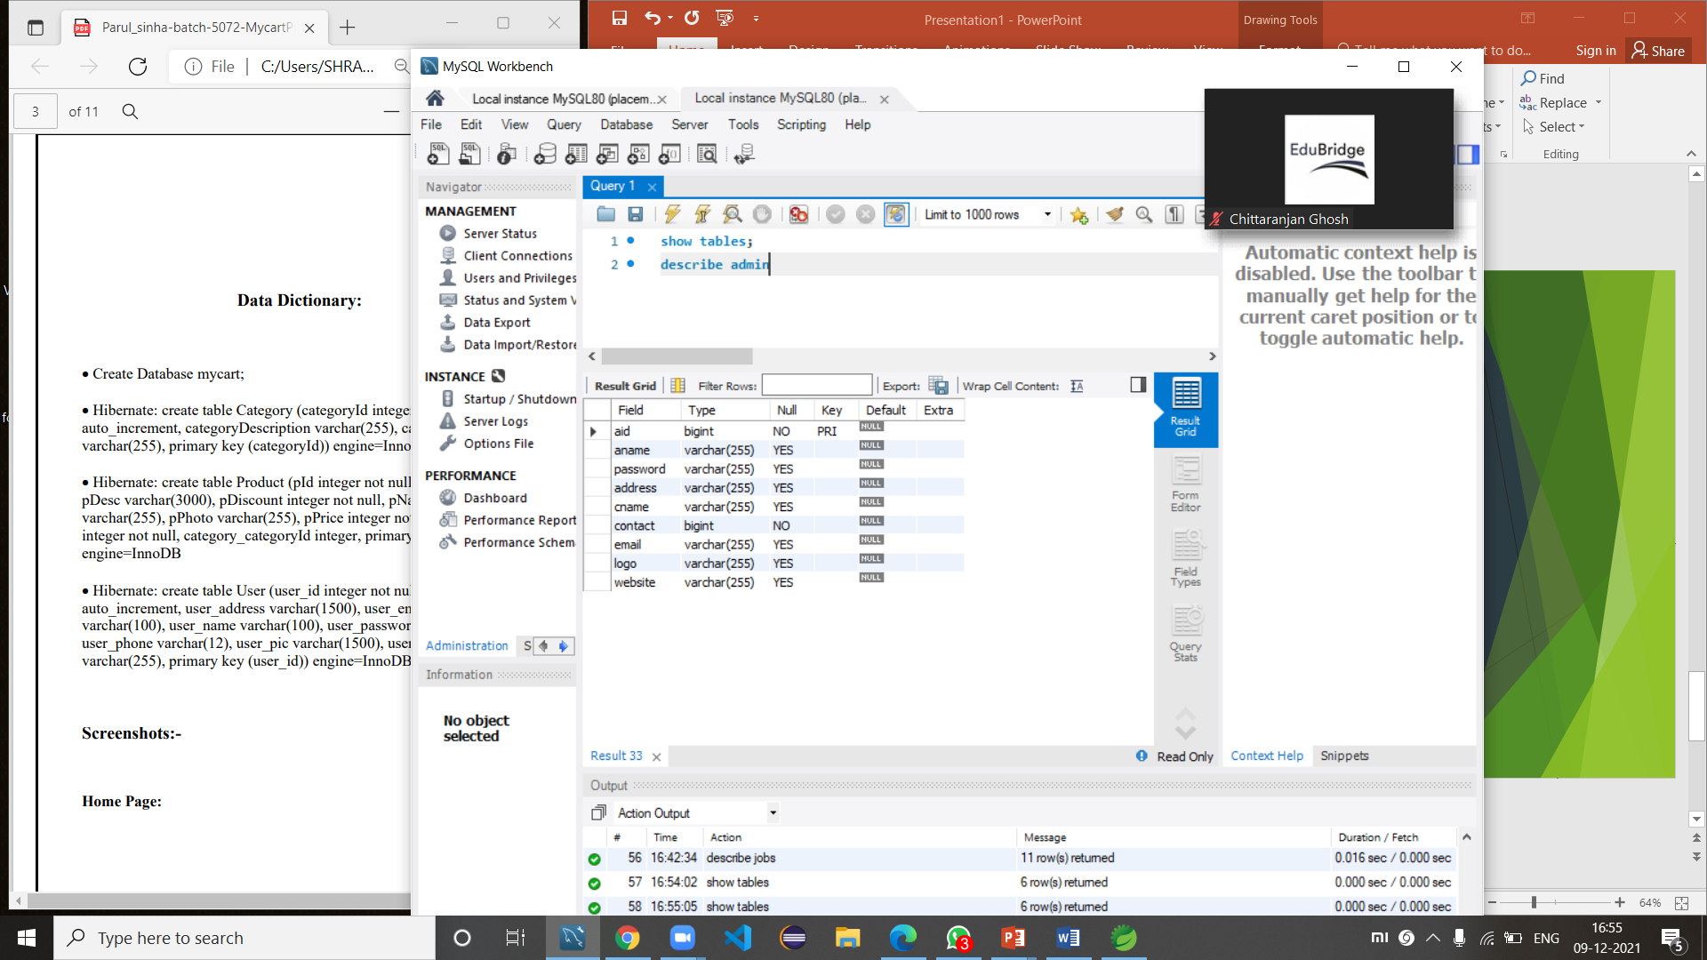
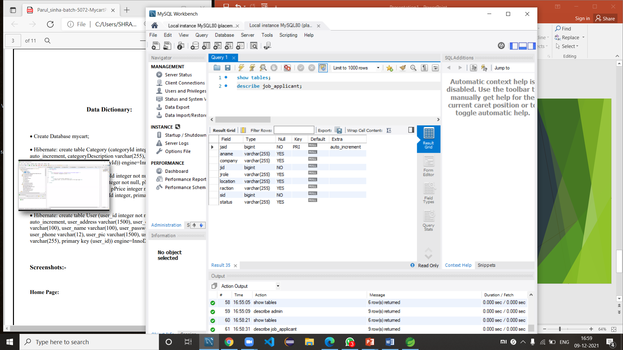
Data Dictionary
Create Database Placement.
Hibernate : Create table Admin :-
Hibernate : Create table Job Applicant :-

Slide 9
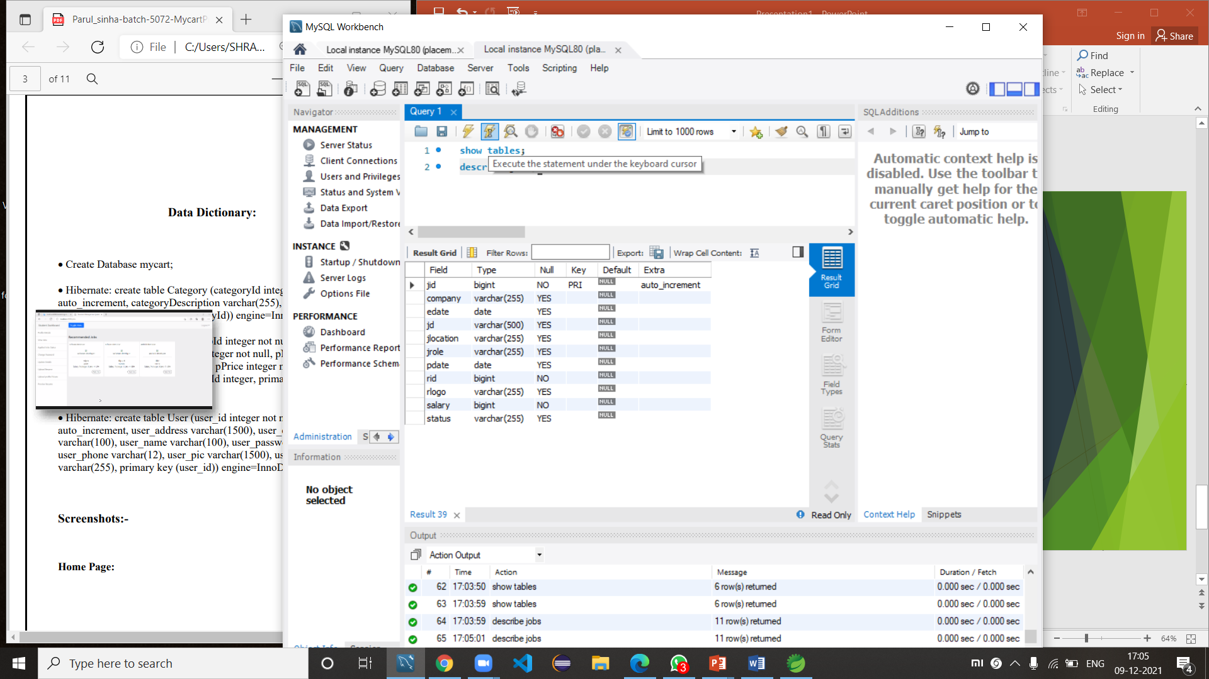
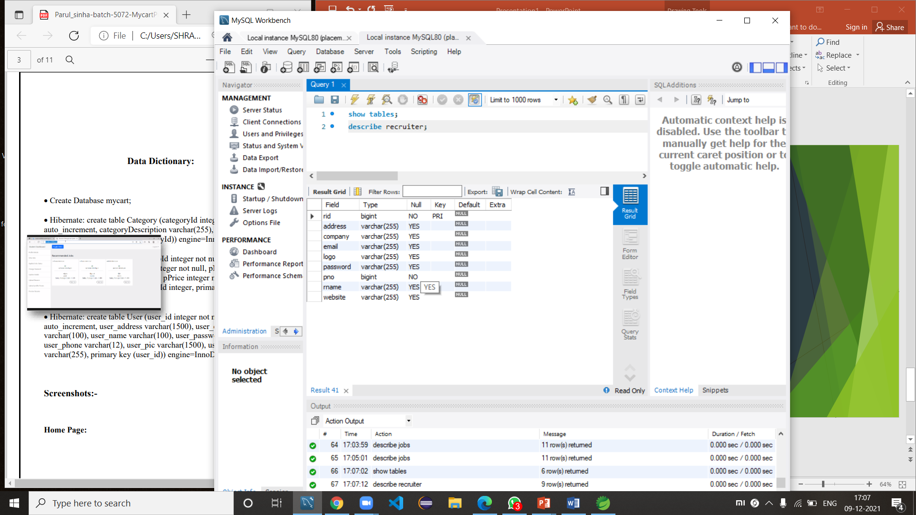
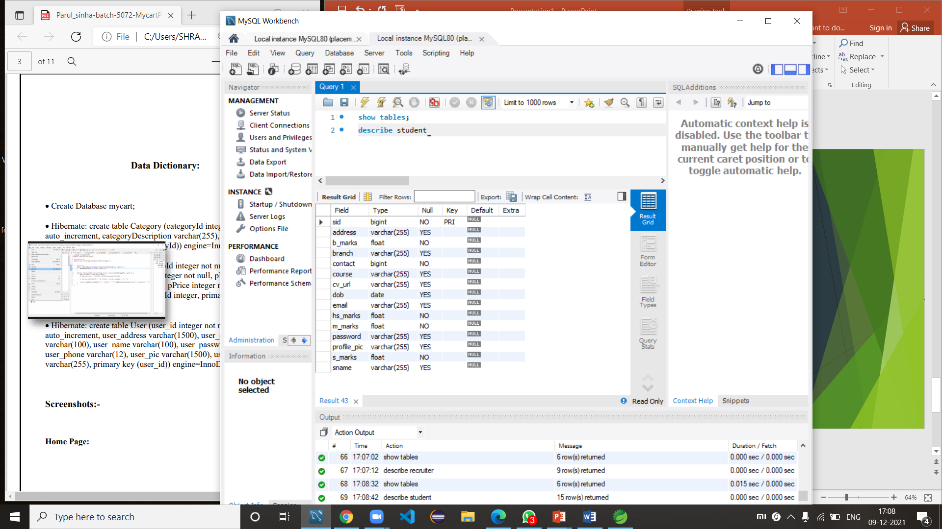
Hibernate : Create table Jobs :-
Hibernate : Create table Jobs :-
Hibernate : Create table Jobs :-

Slide 10
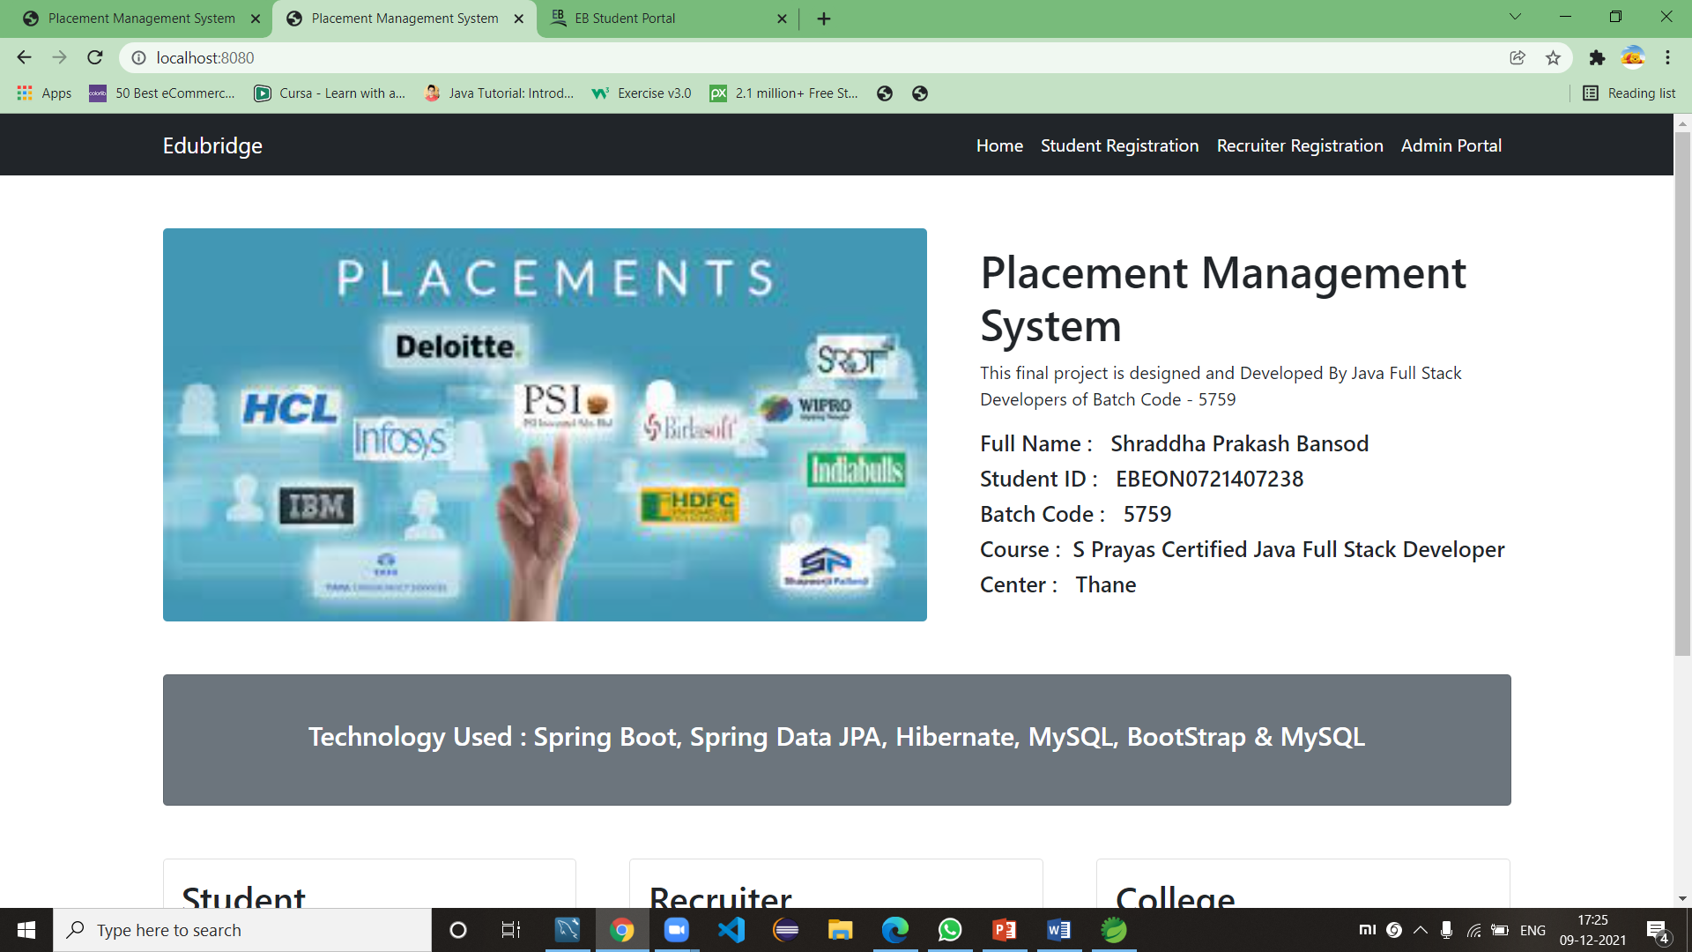
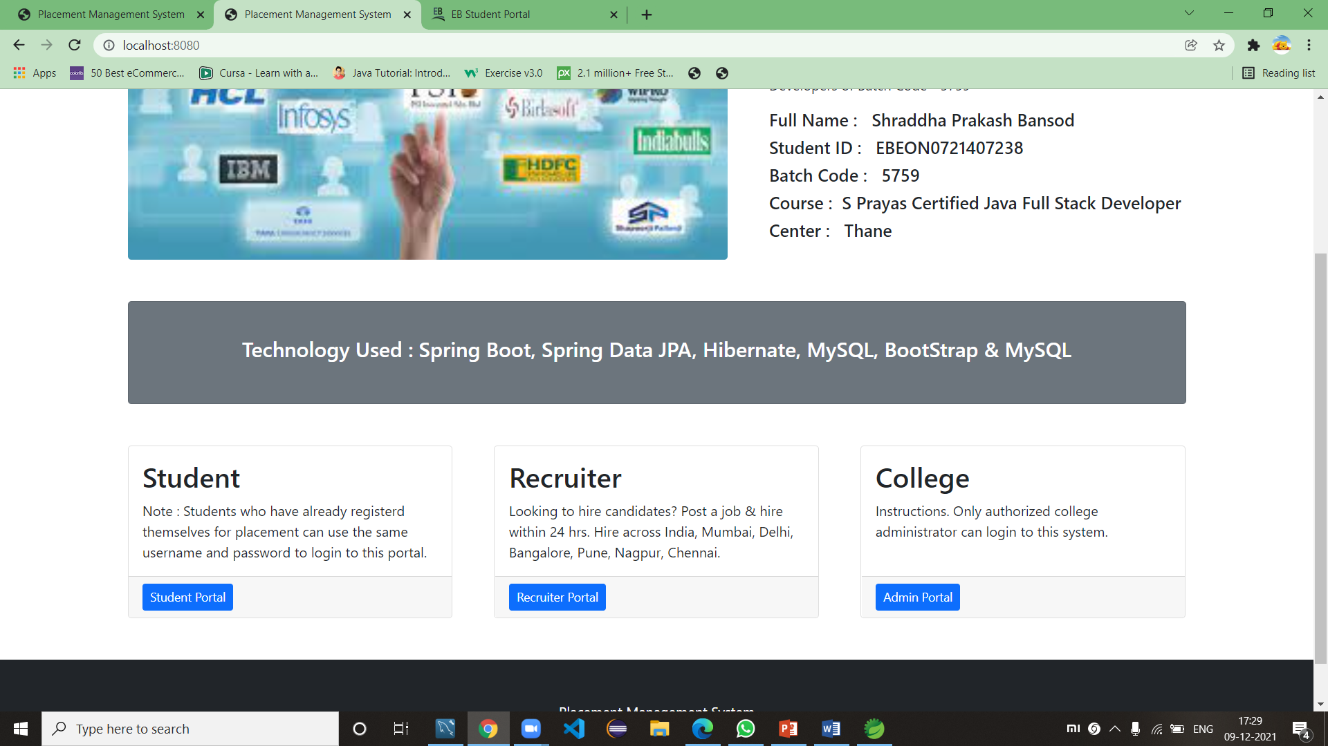
SNAPSHOTS OF TRAINING AND PLACEMENT CELL
HOME PAGE

Slide 11
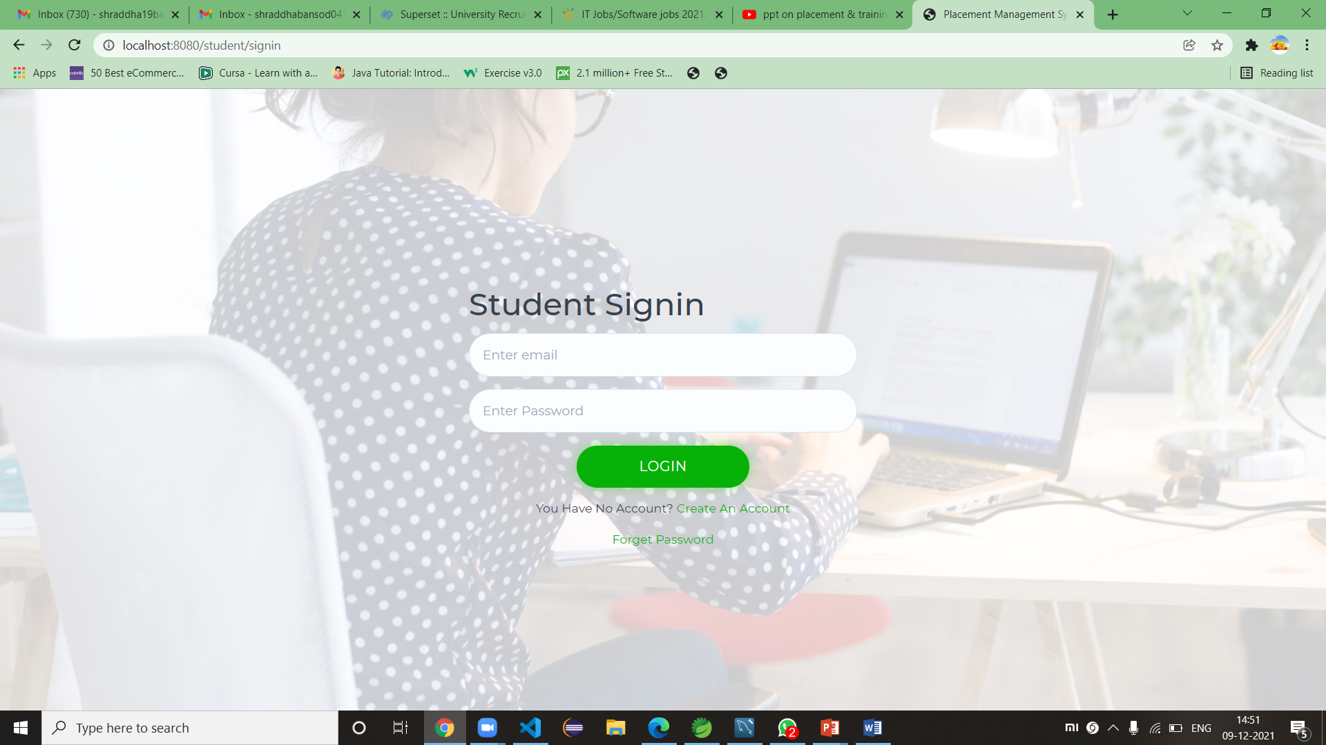
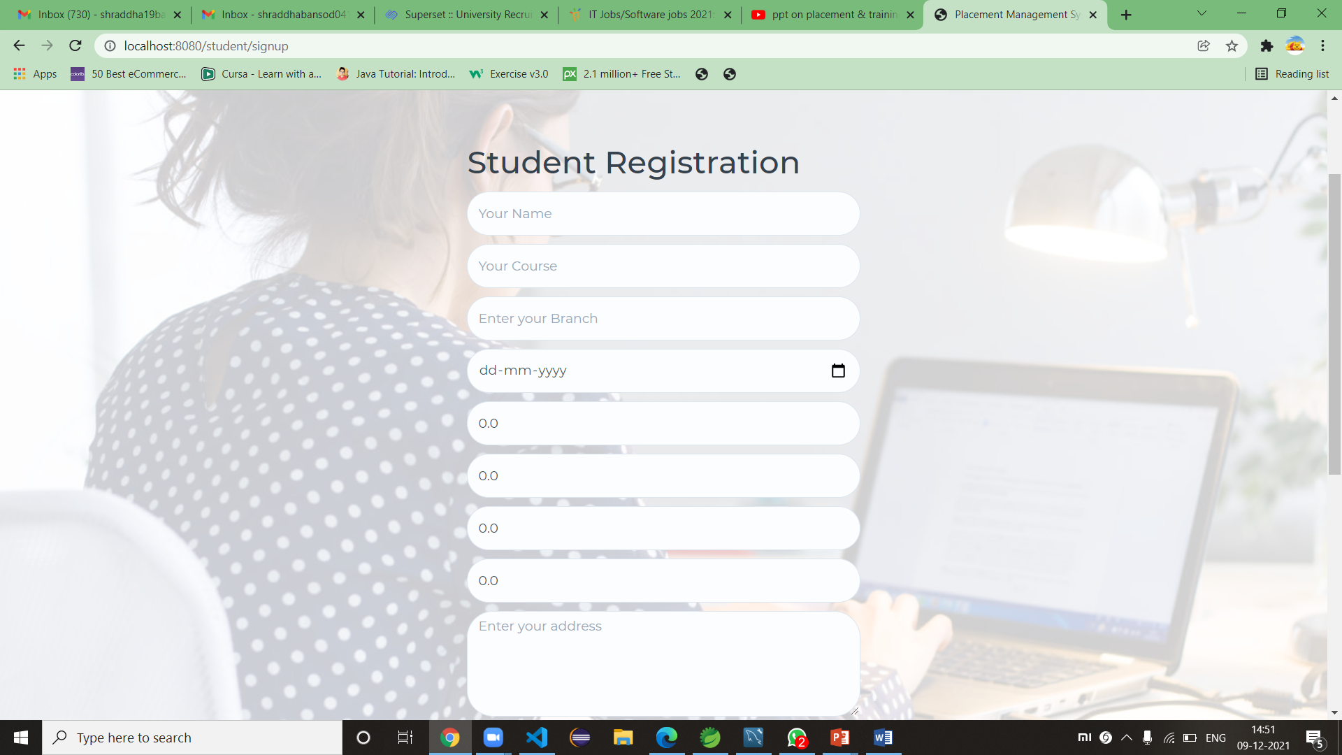
STUDENT PORTAL -
Sign In Page
Sign Up Page

Slide 12
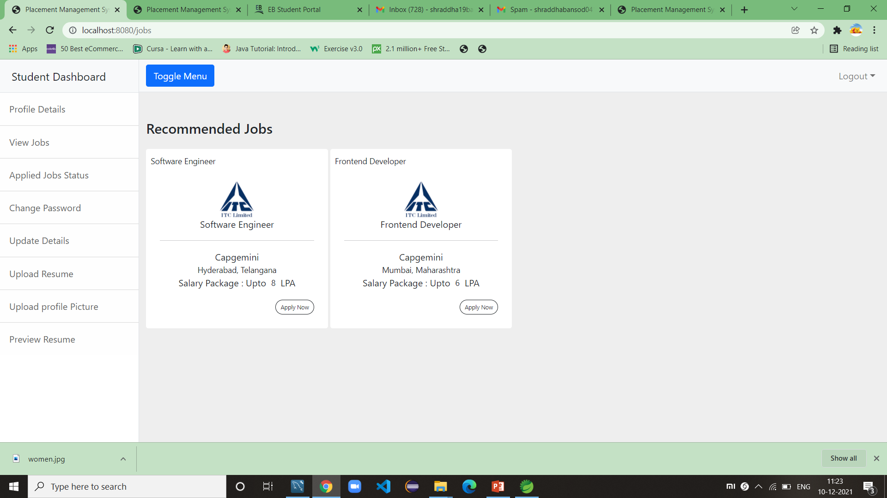
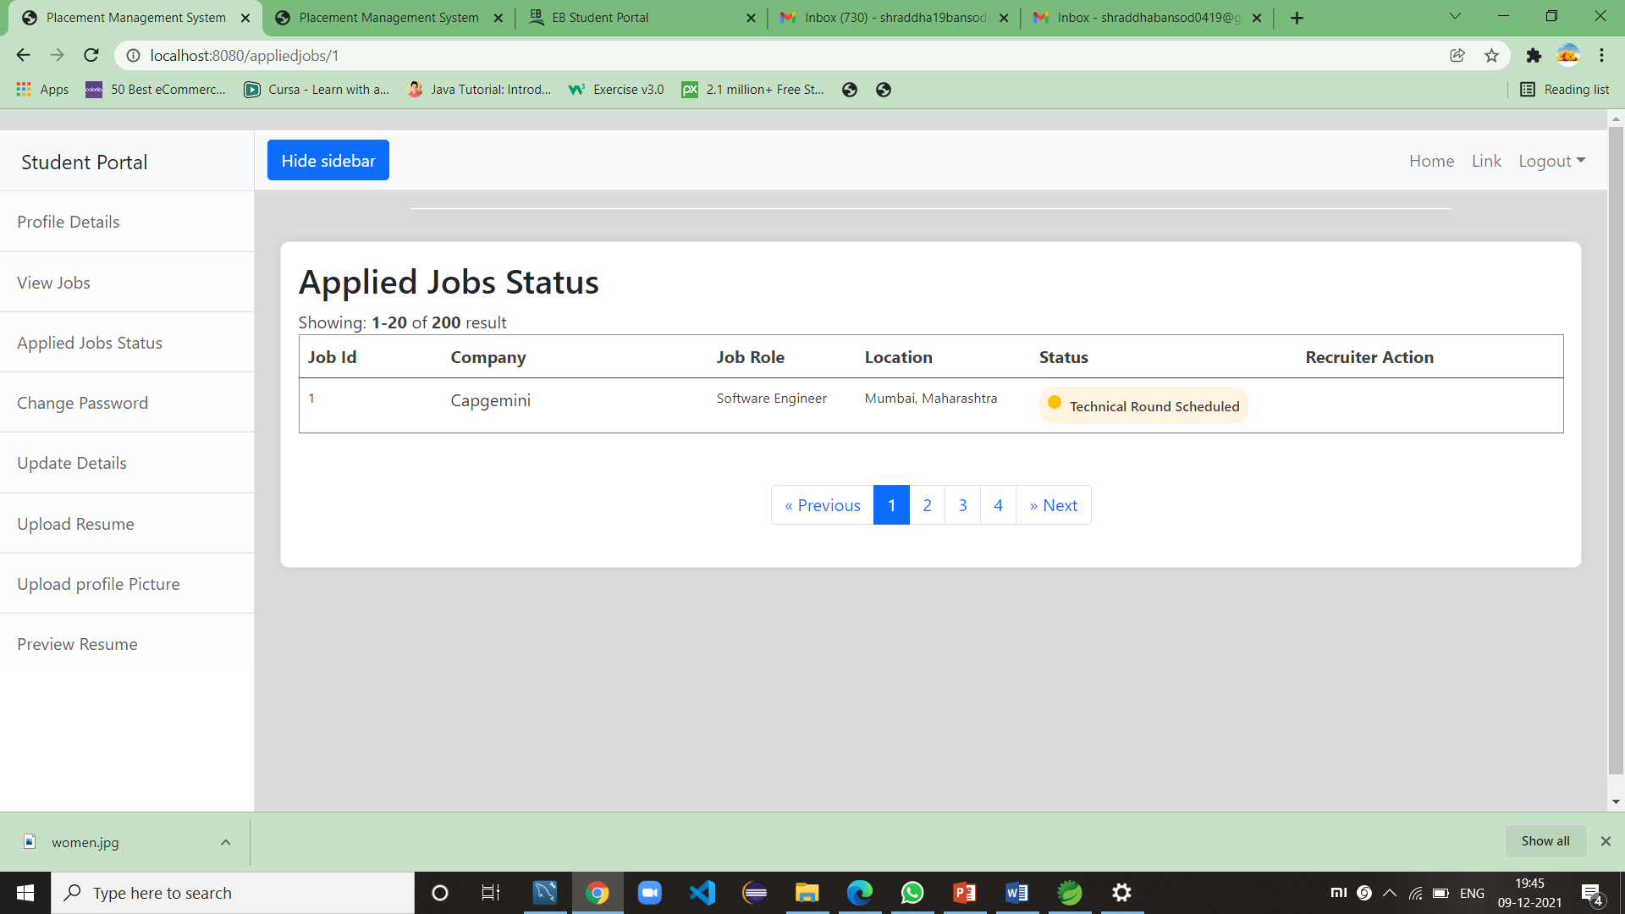
Recommended Job
Applied Jobs Status

Slide 13
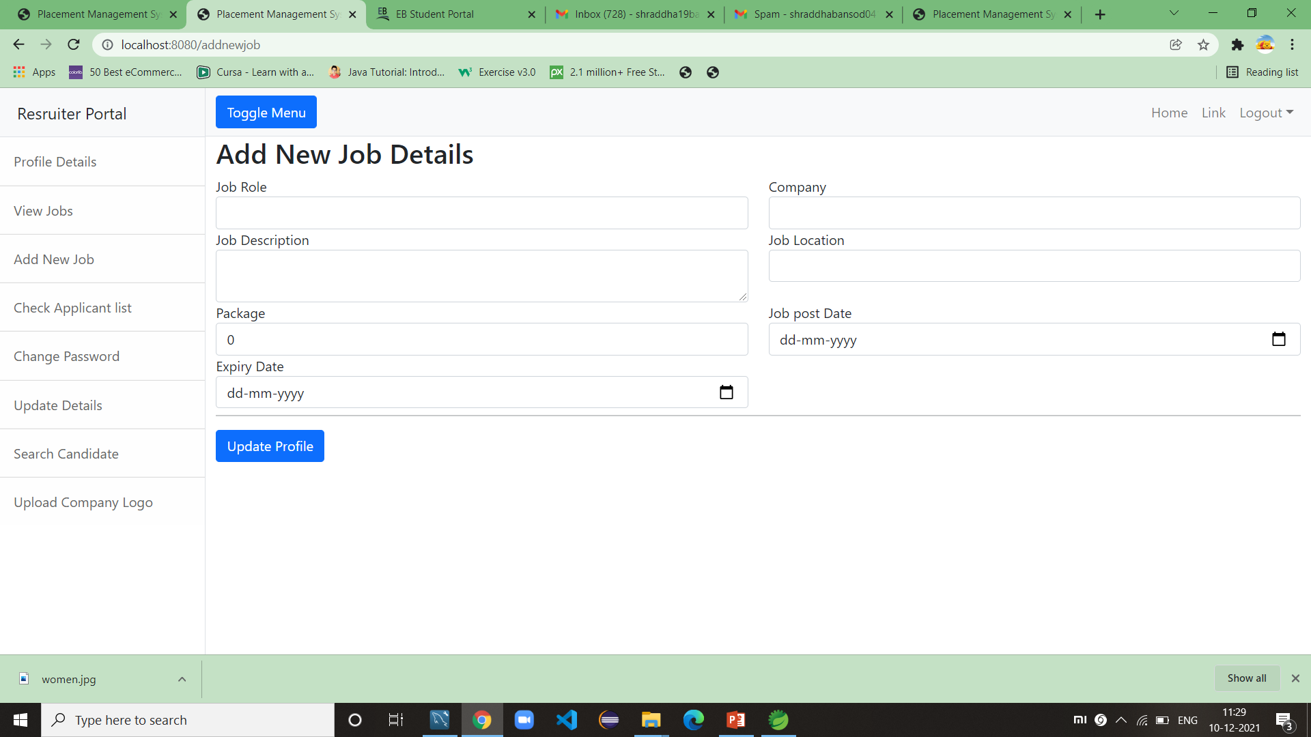
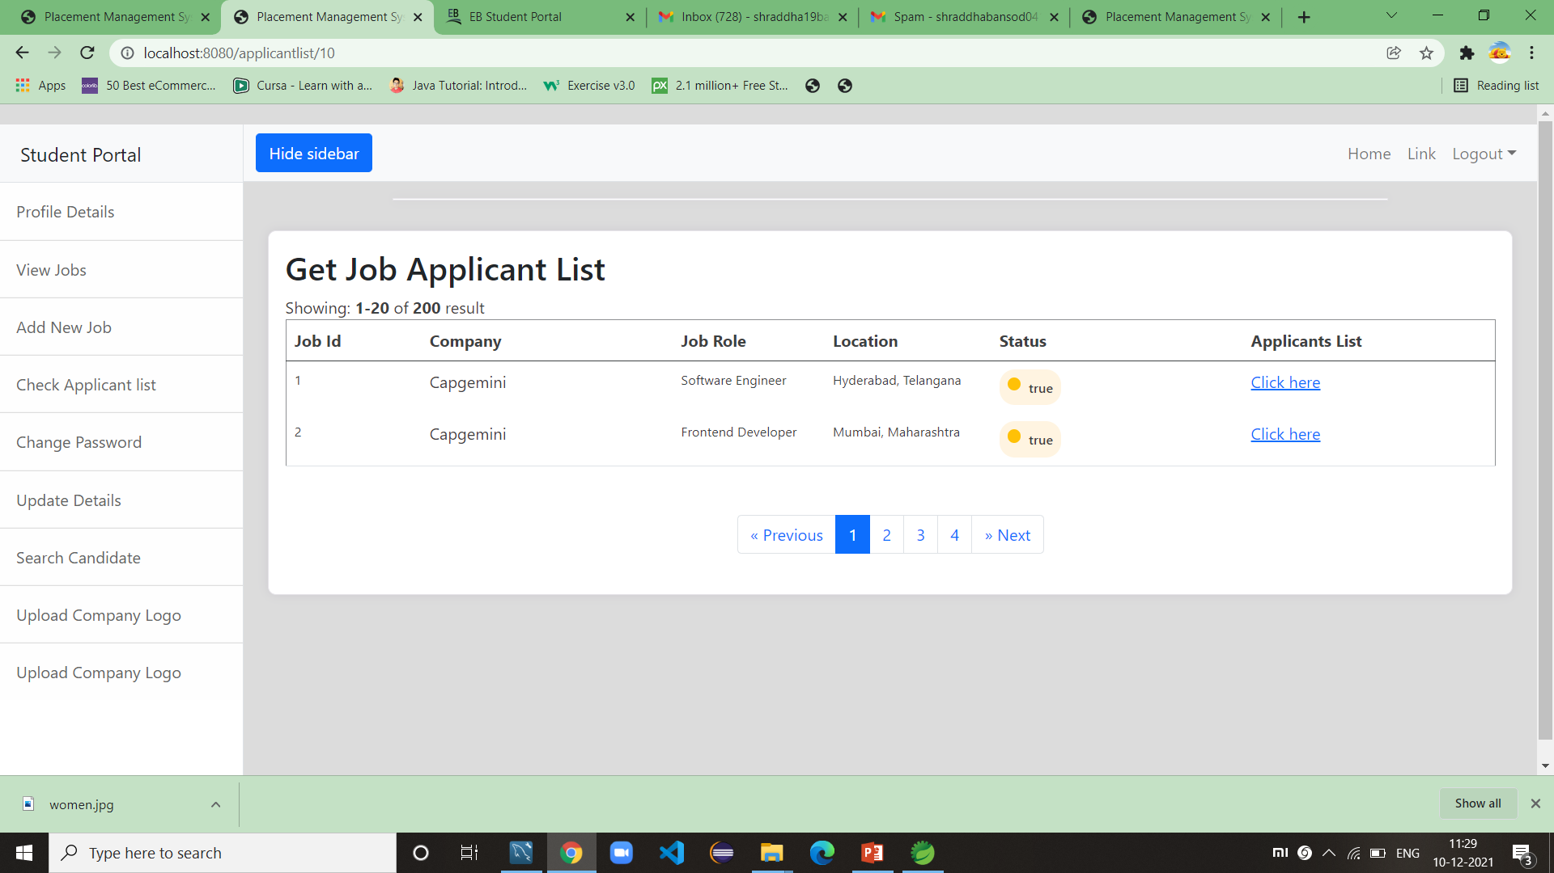
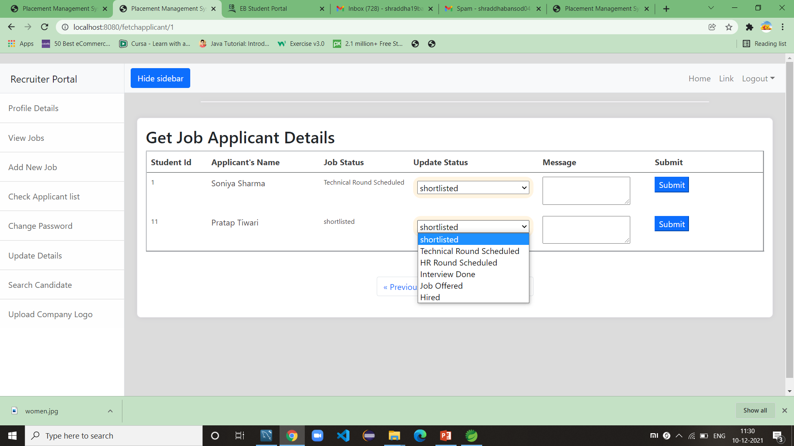
RECRUITER PORTAL -
Add New Jobs Details
Job Applicant List
To Change Applicant Job Status

Slide 14
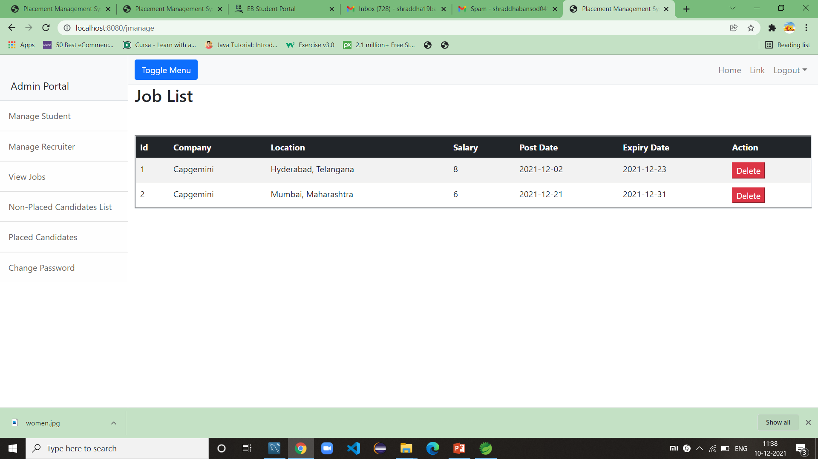
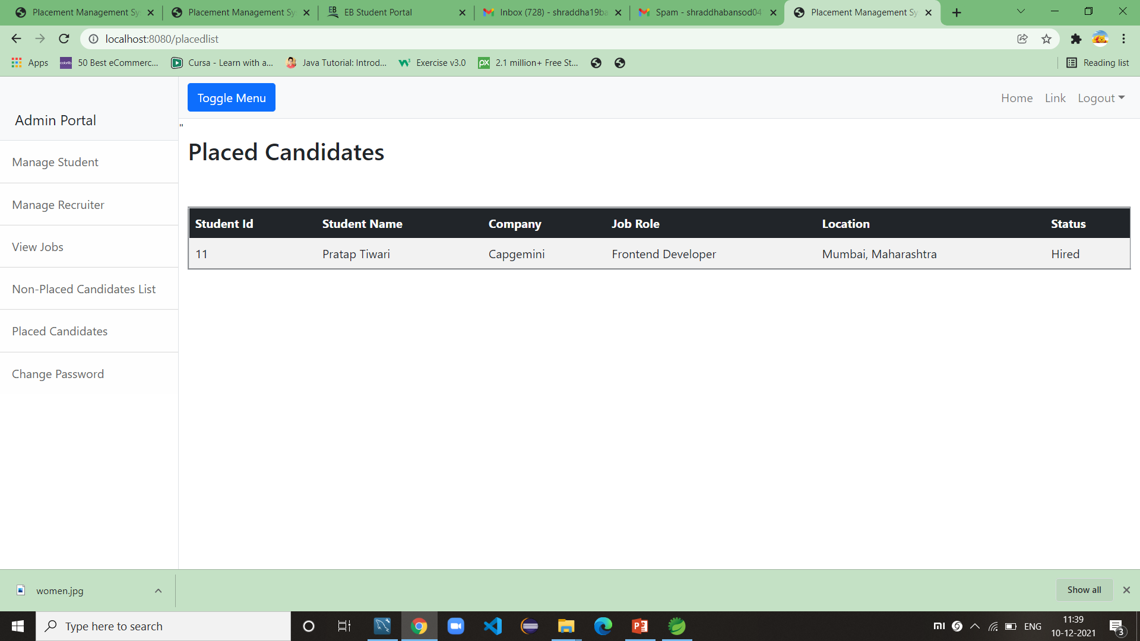
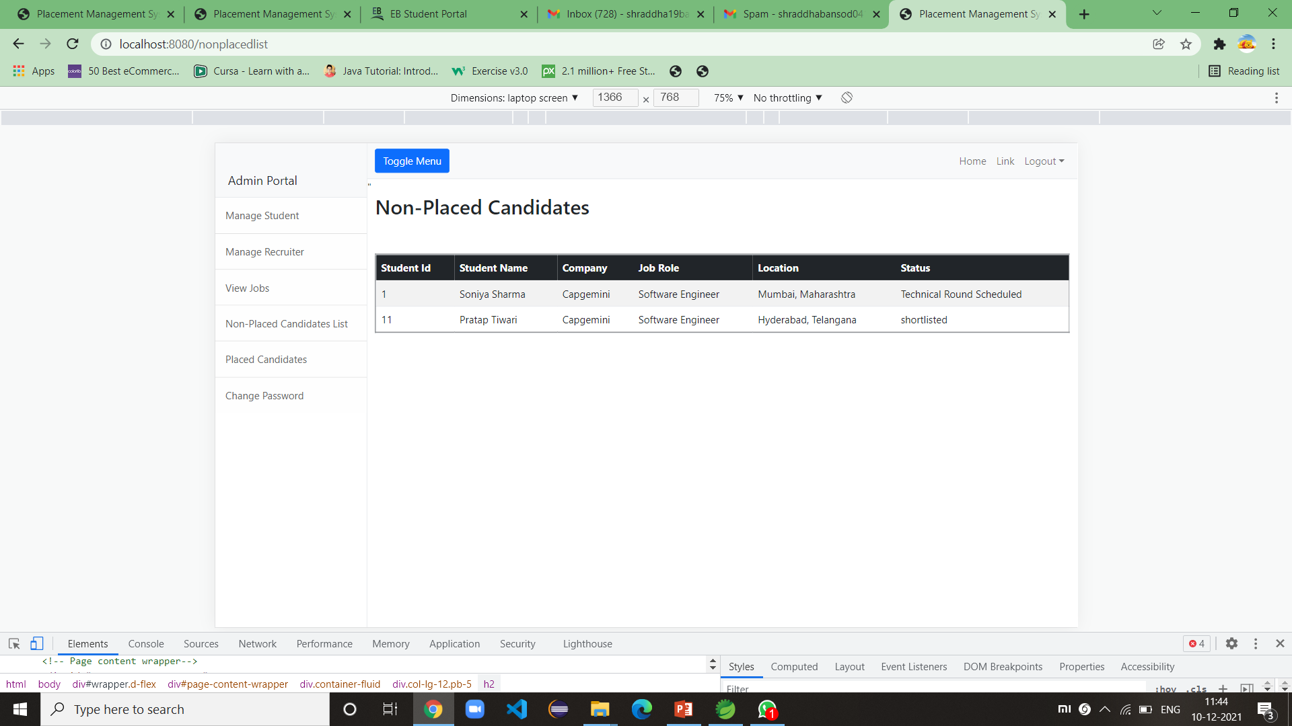
ADMIN PORTAL -
Job List
Placed Candidates
Non-Placed Candidates

Slide 15
Thank You

